Slide 1


A Tweet Today, A Ban Tomorrow: Abortion Trends by US State
Ebuwa Evbuoma-Fike
Amelia Nash
Hana Ateeq
Judy Cha
Taiwo Owoseni
Vika Zhou
2022 DS4A Capstone
Notes:
Everyone introduces self

Slide 2
Correlation One
Outline
01
02
03
04
05
Background
Data
Methods
Findings
Impact
2022 DS4A Capstone
Notes:
Ebuwa

Slide 3
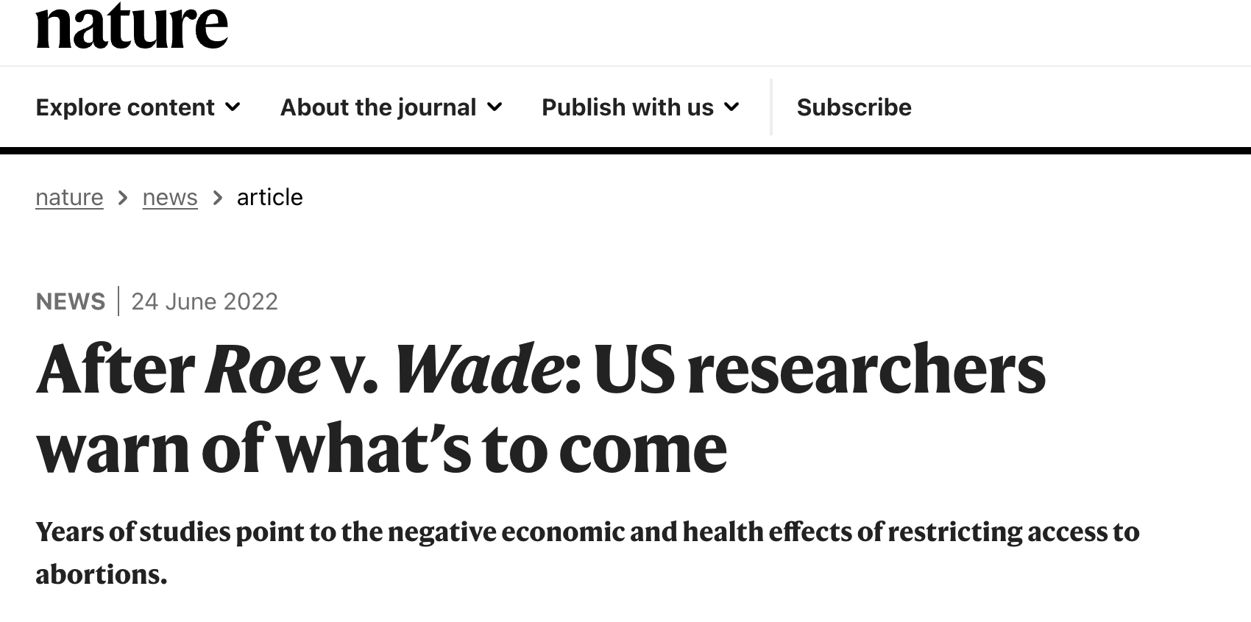
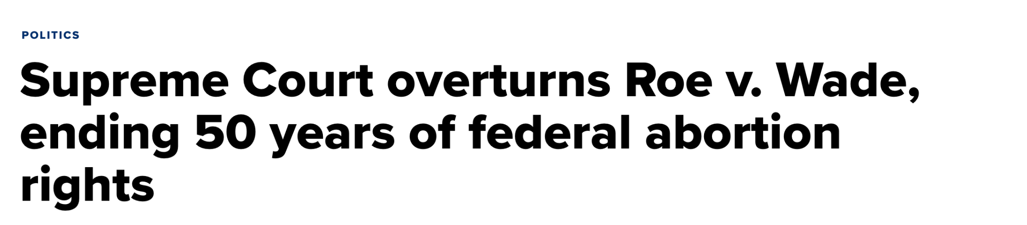
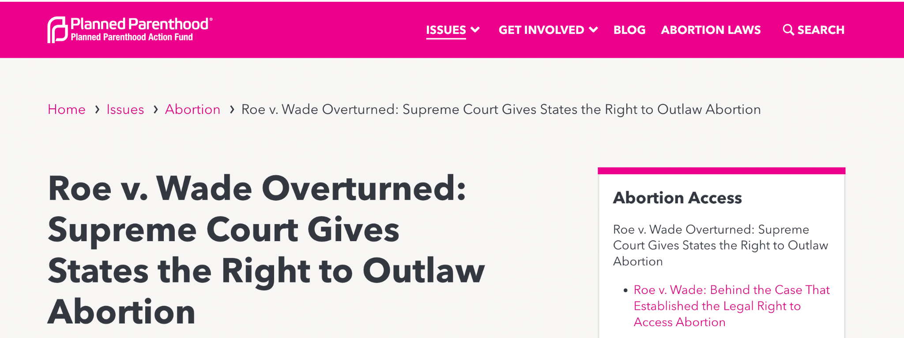
Correlation One
Background
2022 DS4A Capstone
Notes:
Ebuwa
You’re probably all aware that a few weeks ago, the US Supreme Court overturned Roe vs Wade, a legislation on the legality of abortions at the Federal level

Slide 4

Objectives
Correlation One
Findings
To analyze determinants of abortion bans in US states
To analyze public opinion of the recent reversal of the Roe vs Wade ruling
2022 DS4A Capstone
Notes:
Ebuwa
Use predictive modeling to forecast abortion rates by US state based on ban status
Use natural language processing (sentiment analysis) to examine public opinion of the recent reversal of the Roe vs Wade ruling

Slide 5


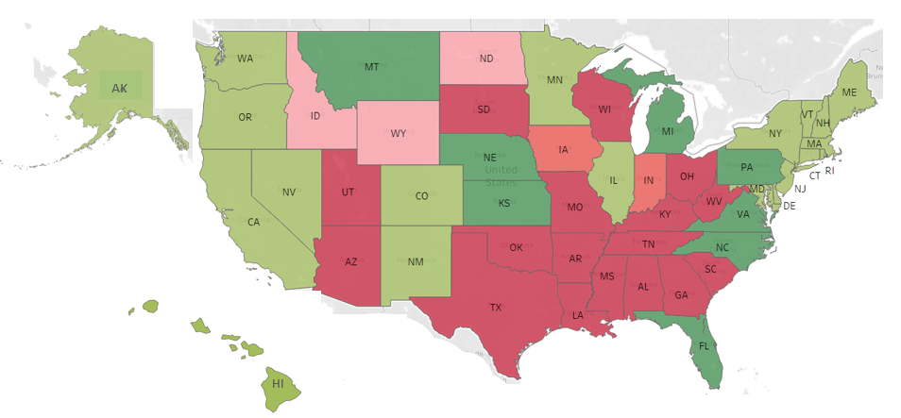
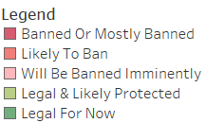
Correlation One
Background
< 30%
Abortion
Mental Health
Socio-Economic
Wellness
Mortality
ROE WADE
2022 DS4A Capstone
Notes:
Hana
Globally, less than a third (29%) of all pregnancies terminate in abortions
Abortion bans do not eliminate abortions
Abortion bans -> Unsafe Abortions -> Mortality
Limited access to safe abortions has long-term effects on
mental health
socio-economic well being
The reversal of the Roe vs. Wade ruling by the US Supreme Court curbs abortion access for women, and has significant implications for women’s health

Slide 6
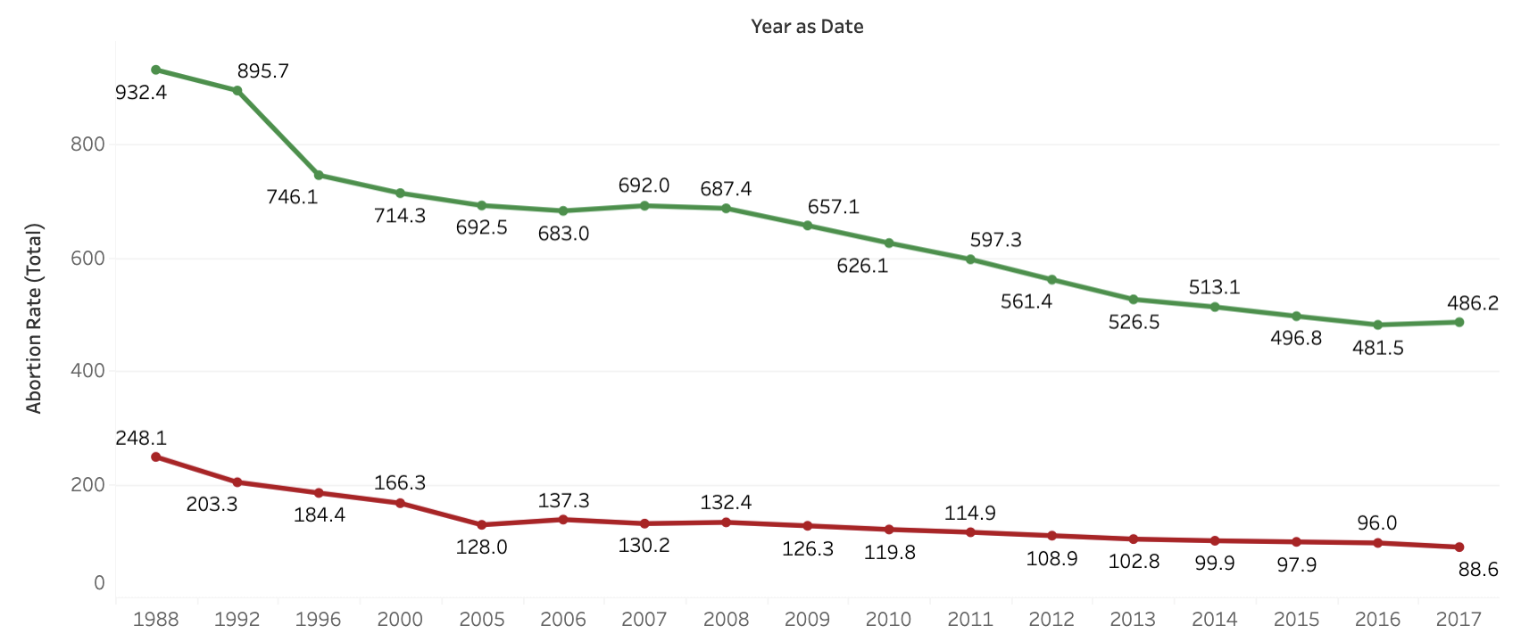
US Abortion Trends: Legal vs Illegal, 1988 to 2017
Notes:
Hana
We wanted to explore the historical trends of legality in the United States.
While relatively high in the late 1980s, in the recent years, there has been a decline in the overall rate of abortions.

Slide 7
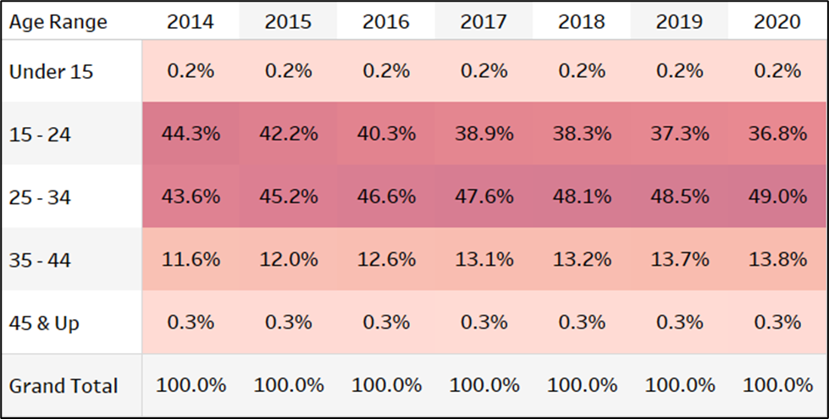
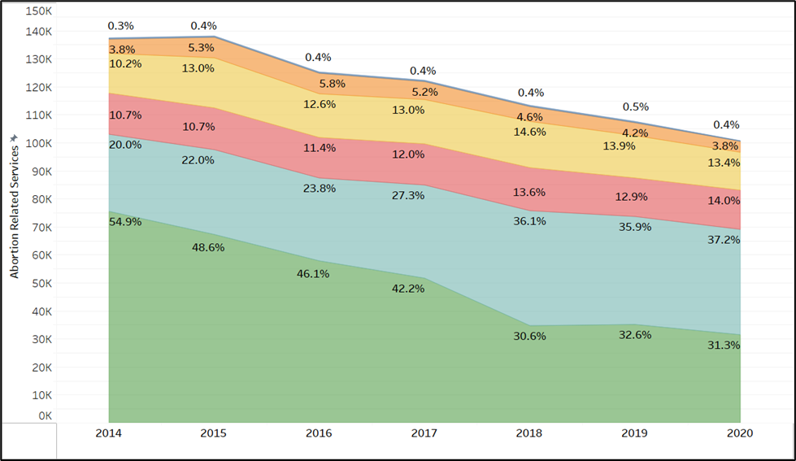
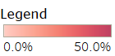
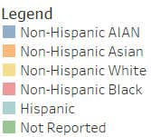
US Abortion Trends: By Race, 2014 to 2020
Hispanic and Non-Hispanic Black women make up the largest proportion of total abortion related services
Women 15-24 years and 25-34 years have the greatest need for abortion services
Notes:
Hana
While exploring the demographics, we discovered that majority of ethnicities are not reported. Amongst those that are reported, the Hispanic and Non-Hispanic Black women make up the largest number of services.
Furthermore, ages 15 to 34 years have the greatest need for abortion services.

Slide 8
Correlation One
Data
01
02
03
04
05
Background
Data
Methods
Findings
Impact
2022 DS4A Capstone
Notes:
Hana
Let’s talk dataset.

Slide 9
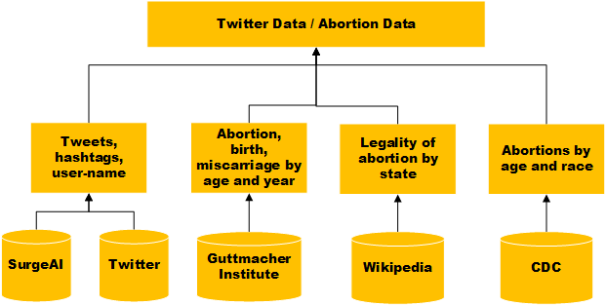
Correlation One
Data
Abortion Status
Classification
Opinion Mining
2022 DS4A Capstone
Notes:
Hana
There were two main datasets used for our modeling: Abortion Status Classification and Opinion Minin.
We used the Guttmacher data for machine learning models and Twitter data for natural language processing.

Slide 10
Correlation One
Data
Data Source
Key Features
State population
Number of pregnancies
Number of abortions
Abortion ban status
913 observations, 1988-2017
Abortion Status
Classification
The Guttmacher Institute
Wikipedia
US CDC
The Pew Research Center
Data Source
Key Features
Tweets
Sentiment Labels
1025 and 50,000 observations, 6/26-7/10
Training, Validation and Test
Surge AI
Twitter
Opinion Mining
2022 DS4A Capstone
Notes:
Hana
The Guttmacher Institute and Wikipedia proved to provide the richest set of data for our project goals. The dataset contains information on the size of each state population, the legality of abortions within that state, the number of pregnancies, births, miscarriages and abortions. Our dataset had 913 observations..
For Opinion Mining, the Surge AI data was used for training with 1025 observations. Data scraping tools was used to pull data from twitter with 50,000

Slide 11
Correlation One
Methods
01
02
03
04
05
Background
Data
Methods
Findings
Impact
2022 DS4A Capstone
Notes:
Amelia

Slide 12

Methods and Tools: Abortion Data
Correlation One
Methods
Aim: To classify abortion ban status by State based on abortion ratios across age groups
Missing values imputed via interpolation to reduce bias
Feature aggregation
2022 DS4A Capstone
Notes:
Amelia
Notes:
After compiling the master abortion data set, we thought it would be interesting to use the pregnancy, birth and abortion data to classify whether or not abortion was banned in each state. The data obtained from the Guttmacher Institute was only collected every 4 years from 1988 to 2005. In order to reduce bias and variance we decided to impute the missing data by using interpolation since we could see the overall abortion number trending down between 1988 to 2017. While doing data exploration we also found that some features were actually aggregate sums of other features in the data set.
Prediction accuracy and difference between the actual and the predictive values (variance)

Slide 13
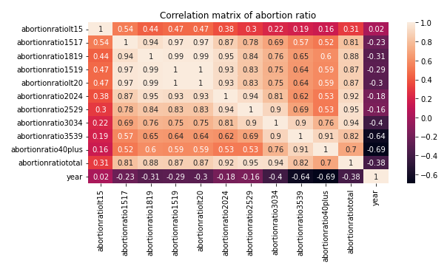
Correlation Matrix: Abortion Ratio, 1988 to 2017
Features (Abortion Ratio)
<20 years
20 to 24 years
25 to 29 years
30 to 34 years
35 to 39 years
>40 years
Notes:
Amelia
As part of our feature selection investigation, we calculated the correlation matrices for each subset of features (abortion rates, pregnancy rates, etc). Computing these coefficients can help us to determine how to reduce dimensionality within the feature set. In other words, transforming the dataset in this way helps to pin down relevant features needed for training the data model.
If the coefficient is > 0.5 ⇒ row and column values are highly correlated and not linearly independent
The 1’s along the diagonal are comparisons of the feature to itself.
Abortion ratio: The number of abortions per 100 pregnancies ending in either abortion or live birth

Slide 14

Abortion Data - (Un)supervised Models
Correlation One
Methods
Logistic Regression
Decision
Tree
PCA
K Means
Regression Based
Decision Tree
Dimensionality
Reduction
Distance Based
2022 DS4A Capstone
Notes:
Vika
Script: in order to better understand what factors is driving abortion ban, we used several machine learning techniques on our demographic dataset, such as logistic regression to estimate the probability if abortion is getting banned, decision tree to learn what factors are driving ban decision, PCA to reduce dimensionality of factors and k-means clustering to identify which groups are closely correlated.
Tools
Visual Studio Code, Jupyter, Google CoLab, Google Docs, Kaggle, Tableau, Python, HackMD, GitHub, Slack
Techniques
All
Exploratory data analysis
Feature engineering
Data visualization
Tweet data
VADER Sentiment Analysis
SVM
Logistic Regression Models
Abortion data
Principal Component Analysis
K-Means Clustering
SVM
Logistic Regression Models

Slide 15

Methods and Tools: Tweet Data
Correlation One
Methods
Aim: To classify tweets as “pro-life” and “pro-choice”
Data Wrangling
Text Statistics
Named Entity Recognition
2022 DS4A Capstone
Notes:
Vika
Script: For another dataset, Tweet Data, we aim to classify tweets as “pro-life” and “pro-choice”. Before we deploy our official NLP analysis, we preprocess our data using data wrangling, figuring out text statistics and recognized named entities like users, locations and emotions.
Word counts: 5 to 30 words: Train data and 5 to 60 words: Test data
Aim: To classify tweets as “pro-life” and “pro-choice”
Data Cleaning
Text statistics
Word counts, character counts
Frequency of stop words vs non-stop words
Named Entity Recognition
Sentiment analysis -> Imbalanced analytical dataset
Predominantly pro-life (73%) vs pro-choice tweets (27%)
Accounted for in model formulations

Slide 16
Twitter Data - Candidate Classifier Models
Correlation One
Methods
Logistic Regression
SVM
XGboost
VADER
Regression Based
Support Vector Based
Tree Based with Boosting
Rule Based
2022 DS4A Capstone
Notes:
Vika
Script: similar to abortion data, we also used logistic regression to predict the probability of being “pro-life” vs “pro-choice”. Newly introduced techniques are like Support Vector Machine and XGBoost to accurately classify the tweets to two groups, and VADER rule based scoring algorithm to better capture sentiment, like positive, negative and neutral.

Slide 17
Correlation One
Findings
01
02
03
04
05
Background
Data
Methods
Findings
Impact
2022 DS4A Capstone
Notes:
JJ

Slide 18
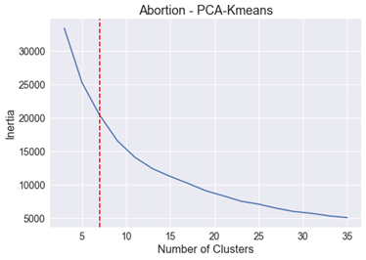
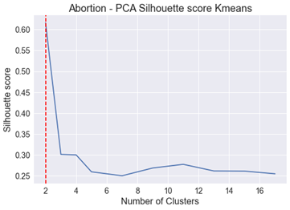
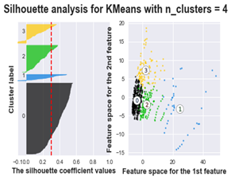
Abortion Data: Unsupervised Learning Model Test Results
Correlation One
Findings
Dimensionality reduction (PCA) is applied to the dataset, followed by k-means clustering
4 clusters optimal due to the lower inertia (distance from mean) and higher silhouette (consistency)
2022 DS4A Capstone
Notes:
JJ
On unseen test data
Silhouette score measures the quality of the clusters selected
Inertia measures how well KMeans clustered the data (sum of the squares of the distance of each data point from its centroid)

Slide 19
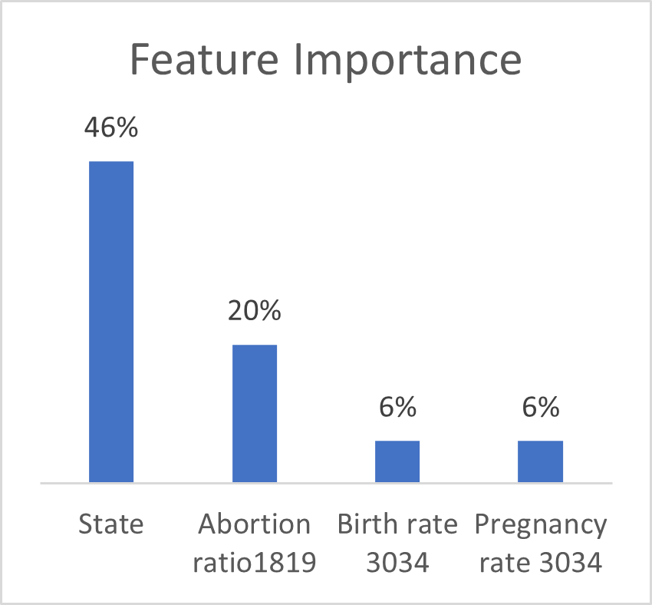
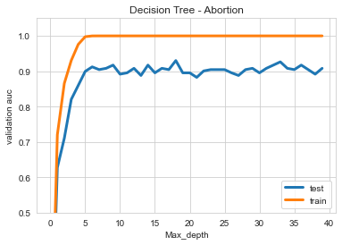
Abortion Data: Decision Tree Model Test Results
Correlation One
Findings
 | 5 fold cross validation
Test score | 93%
High accuracy in decision tree model with 5-depth
Abortion ratio among 18 to 19 year olds is a key feature
2022 DS4A Capstone
Notes:
JJ
On unseen test data

Slide 20
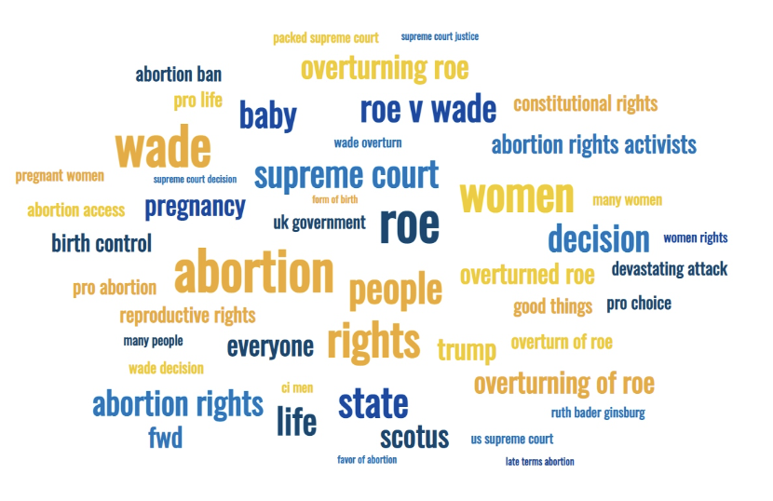
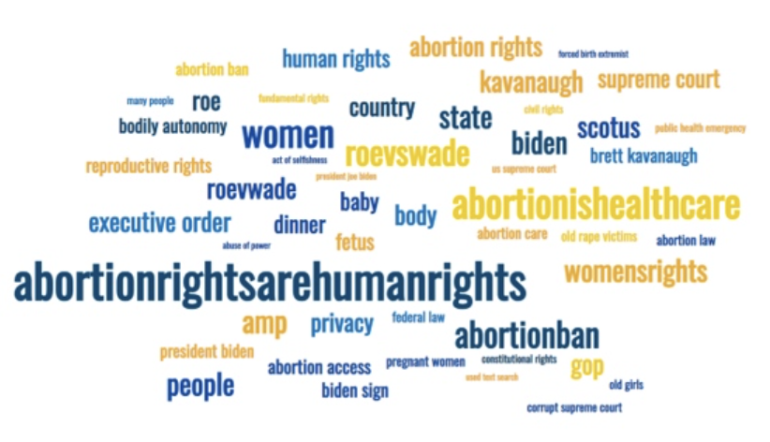
Word Cloud of Tweets: Train vs Test Dataset
Notes:
Taiwo
In the Twitter train dataset, keywords like, “abortion” and “wade” were most prevalent, and keywords such as “Trump”, while the Twitter test dataset had keywords like “abortionrightsarehumanrights” and “Biden”
Most of the tweets described organizations, e.g., the US Supreme Court, and legislation, e.g., “Roe vs Wade”

Slide 21
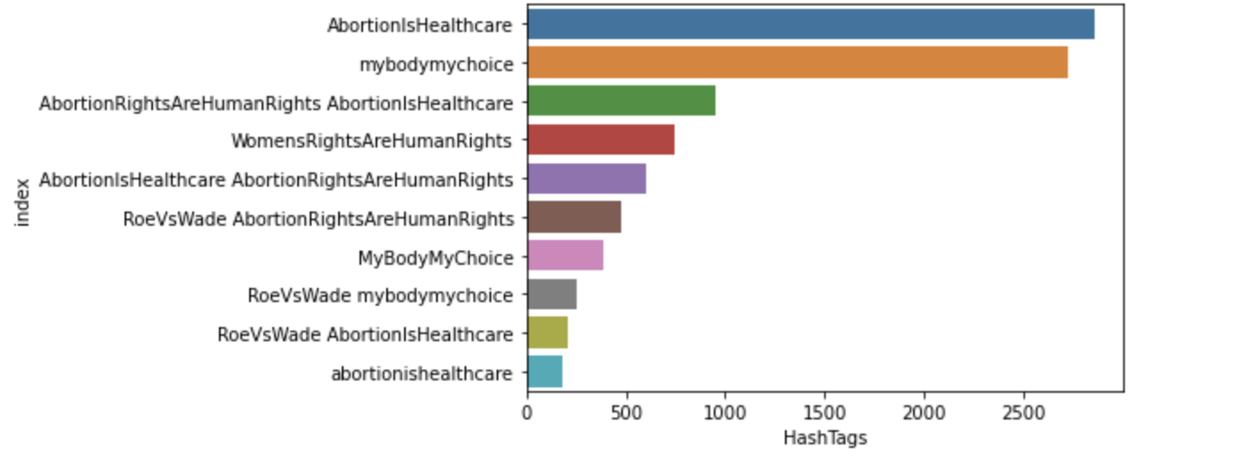
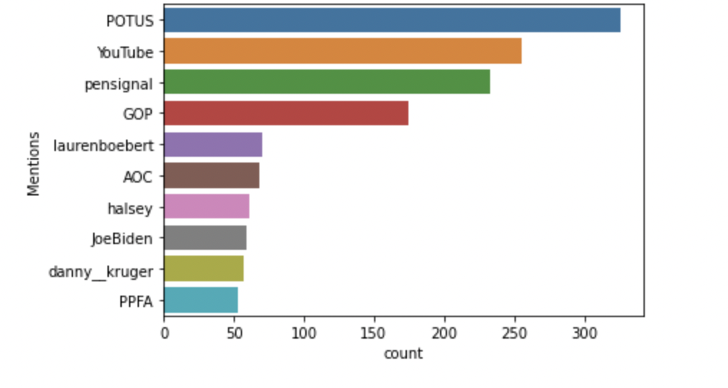
Twitter Statistics: Top Hashtags & User Mentions
Mentions
Hashtags
Notes:
Taiwo
Interesting Hashtags
#AbortionIsHealthcare
#mybodymychoice
#AbortionRightsAreHumanRightsAbortionisHealthcare
#WomenRightsAreHumanRights
Interesting User Mentions
#POTUS
#laurenboebert
#AOC
#JoeBiden

Slide 22
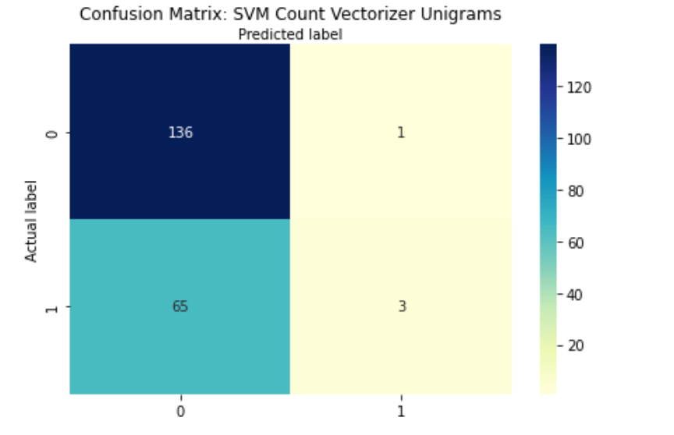
Twitter Data: SVM Model Test Results
Correlation One
Findings
Confusion Matrix
 | Scores
AUC | 72%
Accuracy | 68%
Recall | 4%
Precision | 75%
2022 DS4A Capstone
Notes:
Taiwo
Support Vector Machine is a supervised learning model that
Our model had 72% probability of correctly classifying tweets as pro-life and pro-choice on an unseen test data.

Slide 23
Correlation One
Findings
01
02
03
04
05
Background
Data
Methods
Findings
Impact
2022 DS4A Capstone
Notes:
Ebuwa

Slide 24
Limitations and Opportunities
Correlation One
Restricted access to Abortion Data
Data Quality
Missing Data
With Twitter data of higher quality, we can further identify user groups and sentiment patterns
A safe data warehouse should be put in place for everyone to publicly express abortion opinions
2022 DS4A Capstone
Notes:
Ebuwa
Of course, our analysis does have limitations. For example, we have very restricted access to abortion data, where we can only work on abortion incidence data from 1988 to 2017, which only consists of 913 observations; also, due to non-academic Twitter API rate limits, we were unable to expand our sample to include location data and the abortion dataset we received had missing values, so we had to apply linear interpolation method to fill data holes prior to any analysis.
The abortion analysis project indeed presents some opportunities to everyone who is concerned about abortions. If we can have better twitter data of higher quality, we can further identify user groups and sentiment patterns. Another improvement is to build safe data warehouse should be put in place for everyone to publicly express abortion opninions.

Slide 25
Real World Impact
Correlation One
The presence or absence of an abortion ban
is affected by state of residence
Women 18 to 19 years of age are most likely to be affected by abortion bans
2022 DS4A Capstone
Notes:
Ebuwa
Notes: These findings align with studies on demand for abortion-related services across the US. It is clear that abortion bans have wide-ranging consequences. In particular, policy efforts should prioritize outreach to women 18 to 19 years of age.
Abortion bans are ineffective in restricted States - if a State already had a ban, there is no shift in abortion rates?

Slide 26

Thank you! Any questions?
Correlation One
<QR code>
Scan the QR code to see more
2022 DS4A Capstone
Notes:
Ebuwa
Notes: These findings align with studies on demand for abortion-related services across the US. It is clear that abortion bans have wide-ranging consequences. In particular, policy efforts should prioritize outreach to women 18 to 19 years of age.
Abortion bans are ineffective in restricted States - if a State already had a ban, there is no shift in abortion rates?

Slide 27
Real World Impact
Correlation One
Abortion bans do not completely eliminate abortions in states where the procedure was
already restricted
Although 30% of women who receive abortions do not report their race, the data still shows that
Hispanic and Non-Hispanic Black women
will be most impacted by the ban
2022 DS4A Capstone
Notes:
Ebuwa
Notes: Hispanic and Non-Hispanic Black women & women ages 15-34 are most impacted
Abortion bans are ineffective in restricted States - if a State already had a ban, there is no shift in abortion rates?

Slide 28
Correlation One
Data
Data Source
913 observations
1988 - 2017
Key Features
State population
Number of pregnancies
Number of abortions
Abortion ban status
The Guttmacher Institute and Wikipedia
Forecast Abortion
Notable Mention
Defects
Four-year data intervals prior to 2005
US CDC and The Pew Research Center
2022 DS4A Capstone
Notes:
The Guttmacher Institute and Wikipedia proved to provide the richest set of data for our project goals. The initial data set pulled from the Center for Disease Control did not have enough features which, in theory, could have contributed to inaccuracy in the prediction model. The final data set contains data on the size of each state population, the number of pregnancies, the number of births, the number of miscarriages, the number of abortions and the legality of abortions within that state. The final data set had 913 rows.
Up until 2005 the data was only collected every 4 years.
The Guttmacher Institute and Wikipedia provided the richest datasets for our project goals
Initial US CDC dataset had insufficient features
Inaccuracies in the prediction model
Until 2005, abortion rates assessed every 4 years
Final data set had 913 rows, including:
State population,
Number of pregnancies,
Number of abortions, and
Abortion ban status

Slide 29
US Abortion Trends: By Age, 2014 to 2020
Women 15-24 years and 25-34 years have the greatest need for abortion services

Slide 30
Correlation One
Data
Data Source
1025 observations
Jun 24 - Jun 27
Key Features
Tweets
Sentiment labels
Training and Validation data
SurgeAI
Opinion Mining
Data Source
50,000 observations
Jun 24 - July 10
Key Features
Tweets
Test data
Twitter
2022 DS4A Capstone
Notes:
SurgeAI data and web scraping of tweets provided the richest datasets for our project goals
snstwitter library (06/24/2022 to 07/10/2022)
Hashtags, mentions, characters & URLs subsetted
Inaccuracies in lemmatization and word stemming
Final datasets:
Train (1025 rows), Test (50,000 rows) including:
Tweet
Hashtags
Sentiment
The first set of tweets was harvested by querying the twitter developer api. One of our original project goals was to examine the location of the user who created the tweet. At the time of this project, the twitter account was limited to a developer role which did not include location data (the account needed to be upgraded to researcher level). As a work around we used Python and the snstwitter library to scrape tweets from the website. We were able to access location data but more often than not the location data would be unavailable. We believe it is because users preferred to keep their location hidden.

Slide 31
Findings: Tweet Data
Correlation One
Findings
In the Train dataset, keywords like,”abortion” and “Wade” were most prevalent, while the Test dataset had keywords like “abortionrightsarehumanrights” and abortionishealthcare”
Most of the tweets described organizations, e.g., the US Supreme Court, and legislation, e.g., “Roe vs Wade”
Tweets vectorized via sci-kit learn CountVectorizer module
Model evaluation
SVM model > Logistic Regression models
2022 DS4A Capstone
Notes:
How did you address this problem with the appropriate datasets, analysis methods, and data technologies?
Note: It is important to have data for each year under examination when surveying trends.

Slide 32
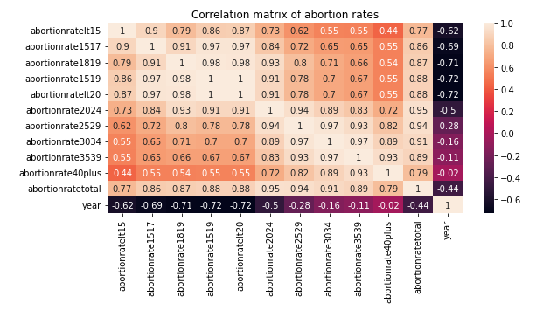
Correlation Matrix: Abortion Rates, 1988 to 2017
Value > 0.5 ⇒ row and
column values are highly
correlated and not linearly
independent

Slide 33
Twitter Statistics: Top Hashtags
Notes:
In the Twitter test data

Slide 34
Findings: Tweet Data
Correlation One
Methods
In the Training dataset, keywords like,”abortion” and “Wade” were most prevalent, while the Test dataset had keywords like “abortionrightsarehumanrights” and abortionishealthcare”
Most of the tweets described organizations, e.g., the US Supreme Court, and legislation, e.g., “Roe vs Wade”
Tweets vectorized via sci-kit learn CountVectorizer module
Logistic regression model correctly classified 72% of the pro-life tweets
VADER Sentiment Analysis model classified 90% of the tweets as “pro-life”, and 10% as “pro-choice”
In contrast to 73% “pro-life” and 27% “pro-choice” classification of the SurgeAI dataset
2022 DS4A Capstone
Notes:
How did you address this problem with the appropriate datasets, analysis methods, and data technologies?
Note: It is important to have data for each year under examination when surveying trends.

